Slide 1
Accuracy Precision Recall FiScore
Sumon Ghosh (9836246393) [sumonghosh.87@gmail.com]

Slide 2
What is the Confusion Matrix?
The confusion matrix is a tool used to evaluate the performance of a model and is visually represented as a table.
It provides a deeper layer of insight to data practitioners on the model's performance, errors, and weaknesses.
This allows for data practitioners to further analyze their model through fine-tuning.
Sumon Ghosh (9836246393) [sumonghosh.87@gmail.com]

Slide 3


Sumon Ghosh (9836246393) [sumonghosh.87@gmail.com]

Slide 4
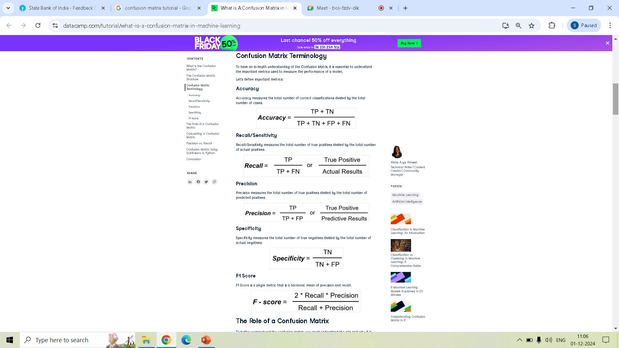
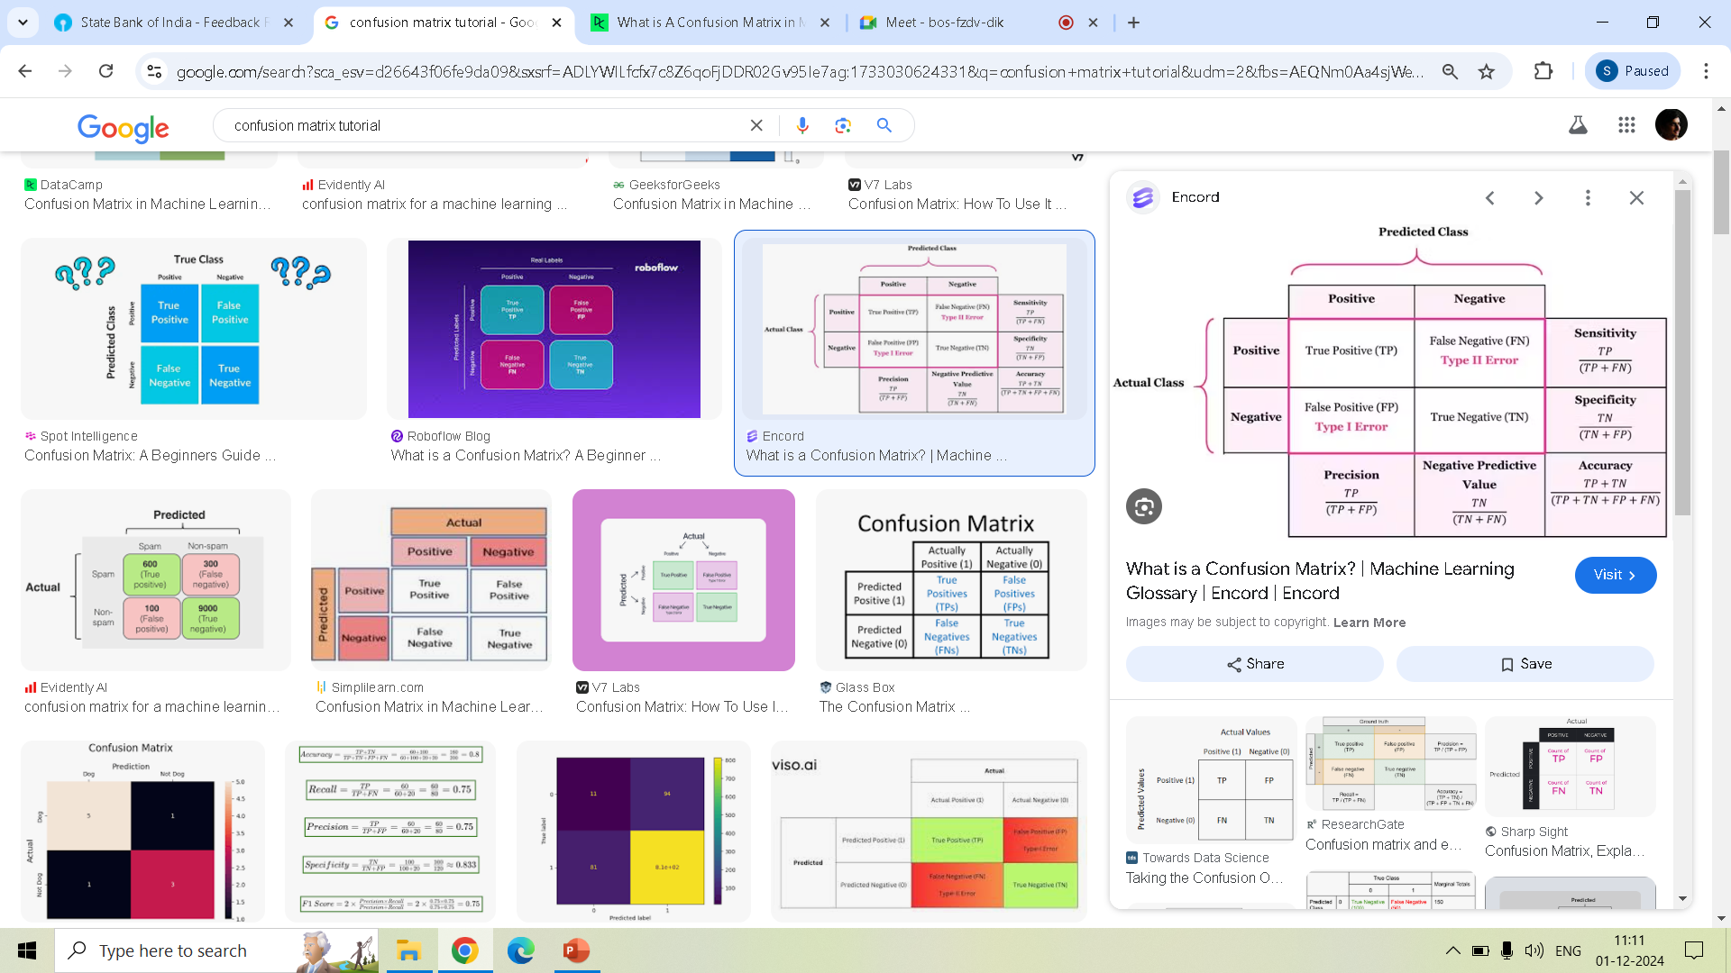
Metrics measure the performance of a model.
Sumon Ghosh (9836246393) [sumonghosh.87@gmail.com]

Slide 5

Sumon Ghosh (9836246393) [sumonghosh.87@gmail.com]

Slide 6
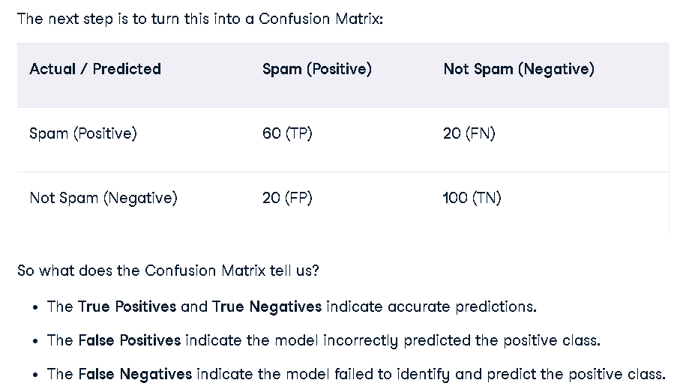
Confusion Matrix
Sumon Ghosh (9836246393) [sumonghosh.87@gmail.com]

Slide 7
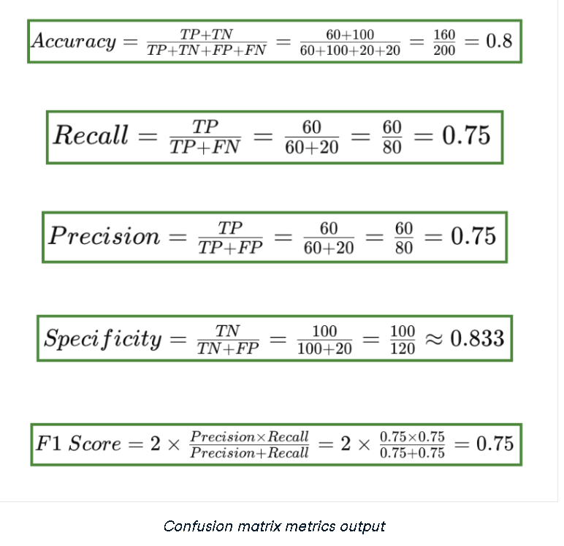
Sumon Ghosh (9836246393) [sumonghosh.87@gmail.com]

Slide 8
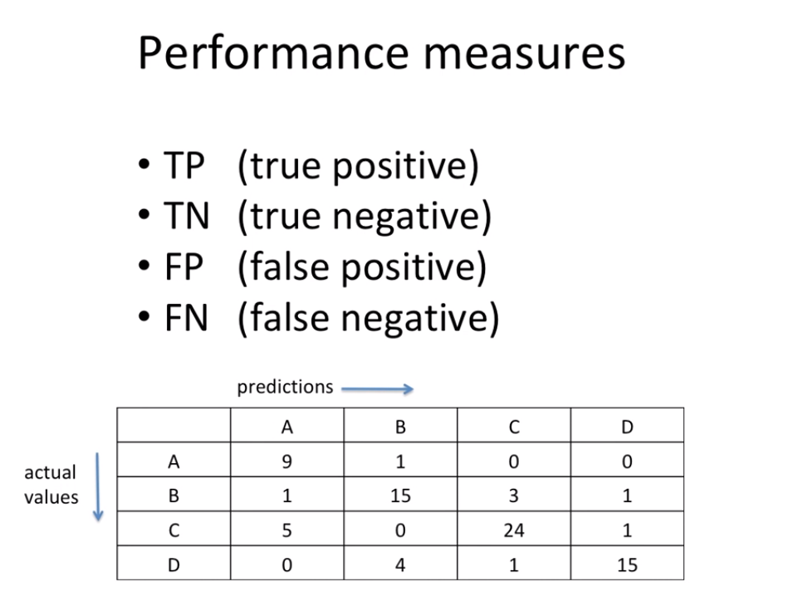
Sumon Ghosh (9836246393) [sumonghosh.87@gmail.com]

Slide 9
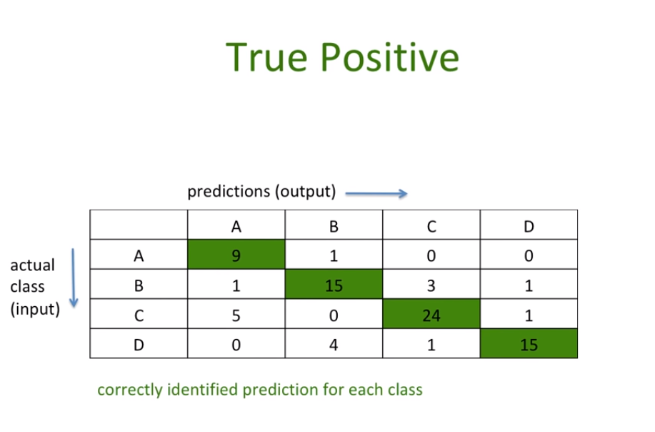
Sumon Ghosh (9836246393) [sumonghosh.87@gmail.com]

Slide 10
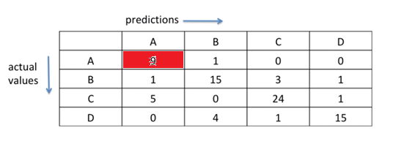
True Positive for A
9
Sumon Ghosh (9836246393) [sumonghosh.87@gmail.com]

Slide 11
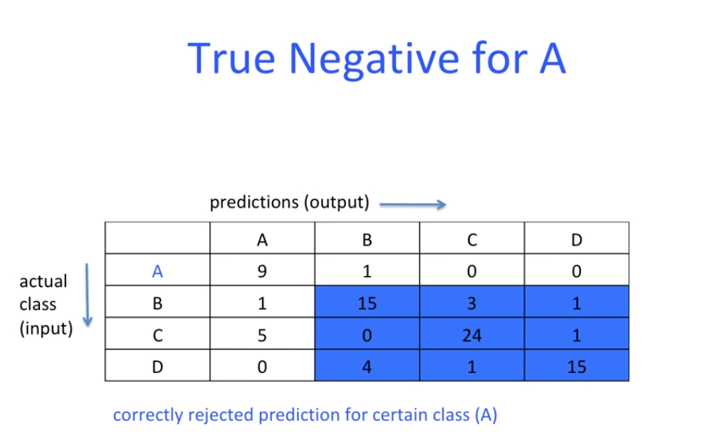
Sumon Ghosh (9836246393) [sumonghosh.87@gmail.com]

Slide 12
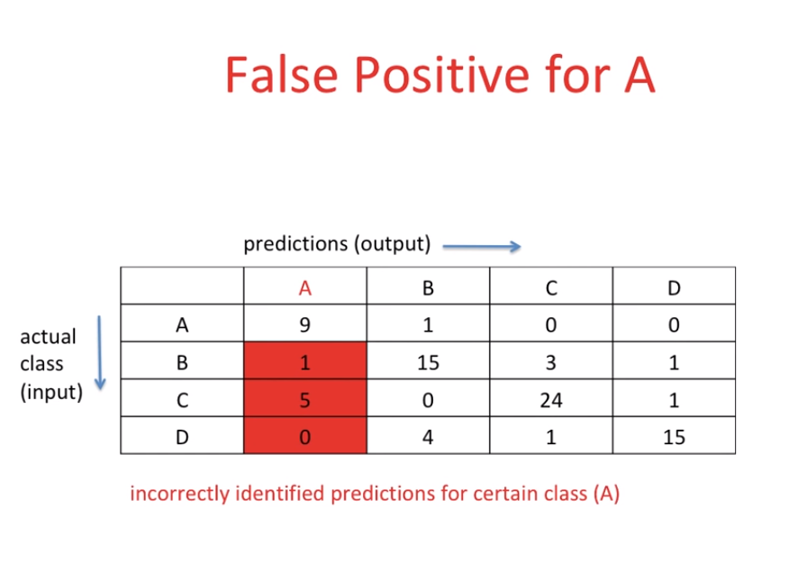
Sumon Ghosh (9836246393) [sumonghosh.87@gmail.com]

Slide 13
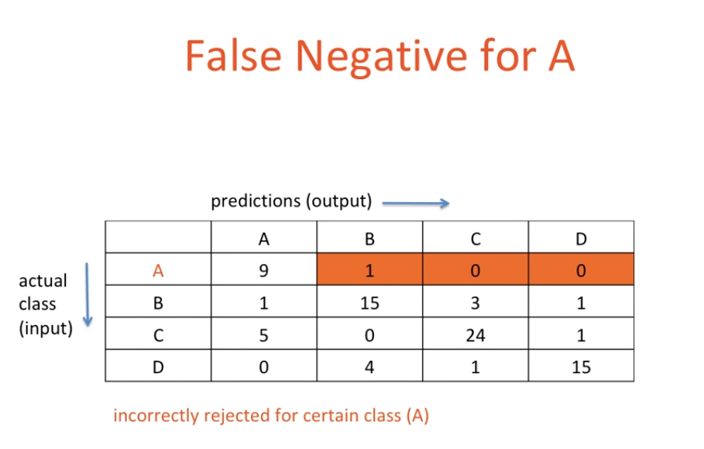
Sumon Ghosh (9836246393) [sumonghosh.87@gmail.com]

Slide 14
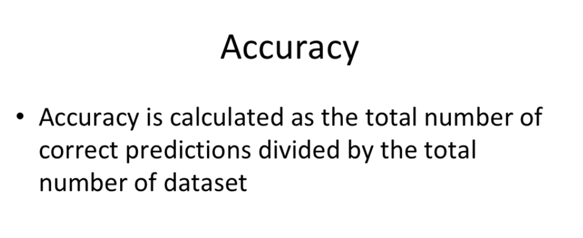
Sumon Ghosh (9836246393) [sumonghosh.87@gmail.com]

Slide 15
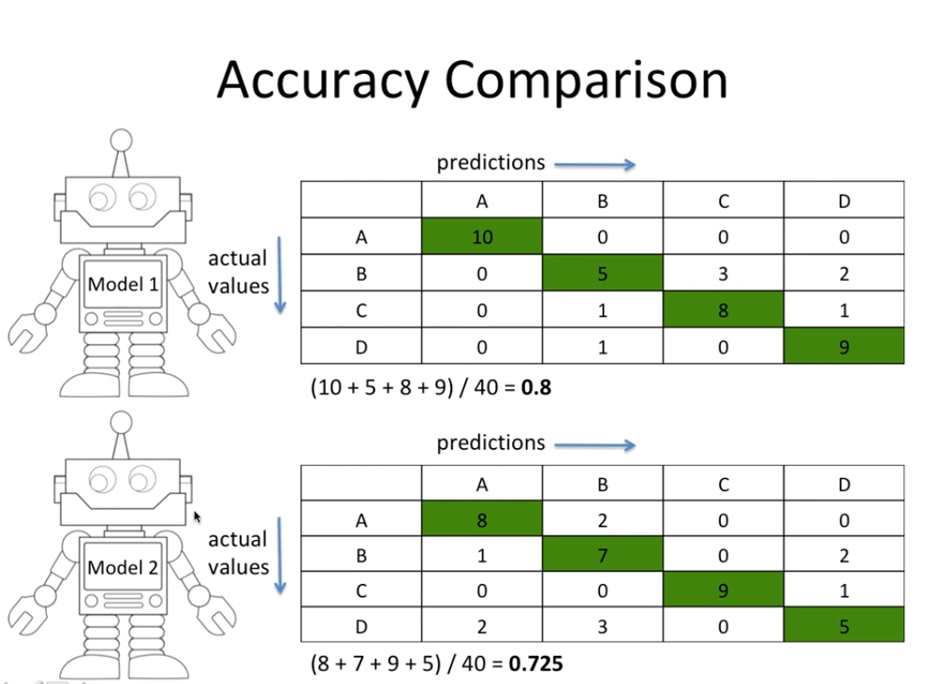
Sumon Ghosh (9836246393) [sumonghosh.87@gmail.com]

Slide 16
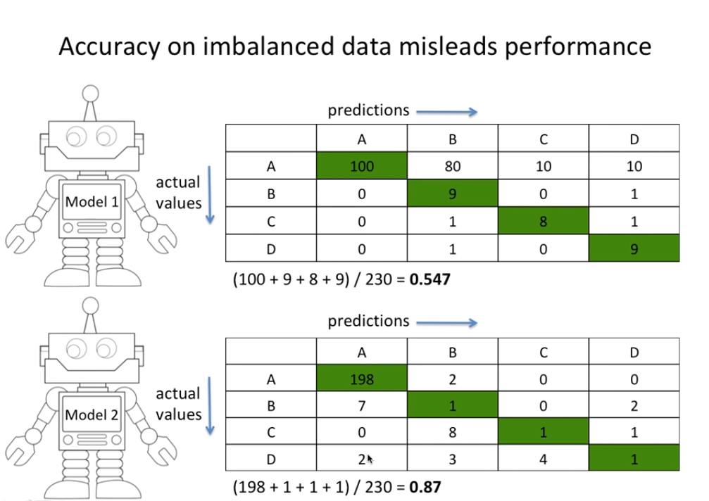
Sumon Ghosh (9836246393) [sumonghosh.87@gmail.com]

Slide 17
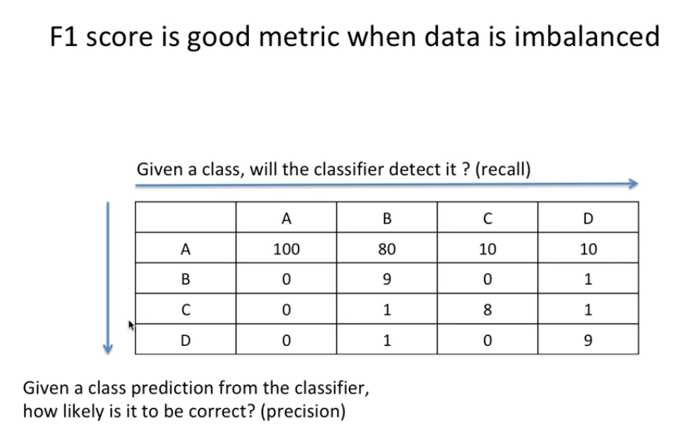
Sumon Ghosh (9836246393) [sumonghosh.87@gmail.com]

Slide 18
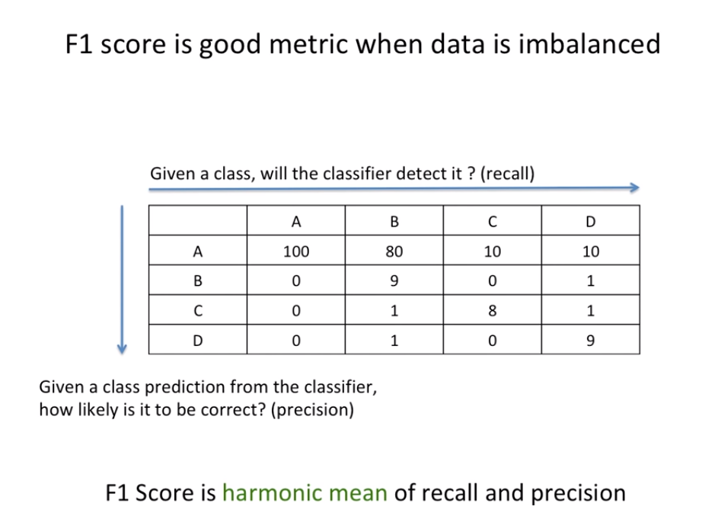
Sumon Ghosh (9836246393) [sumonghosh.87@gmail.com]

Slide 19
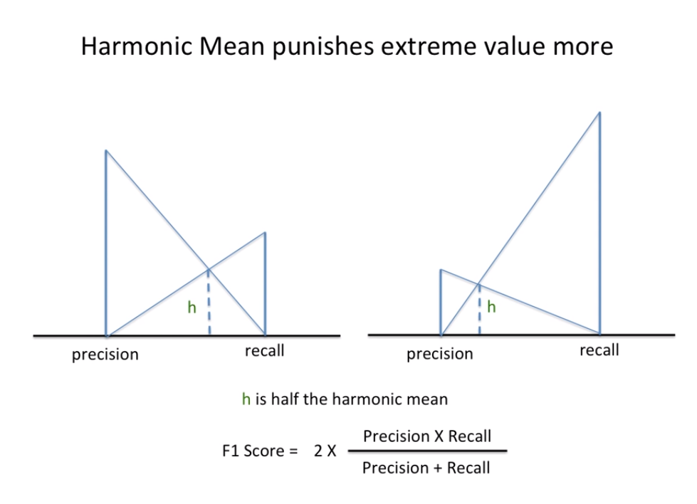
Sumon Ghosh (9836246393) [sumonghosh.87@gmail.com]

Slide 20
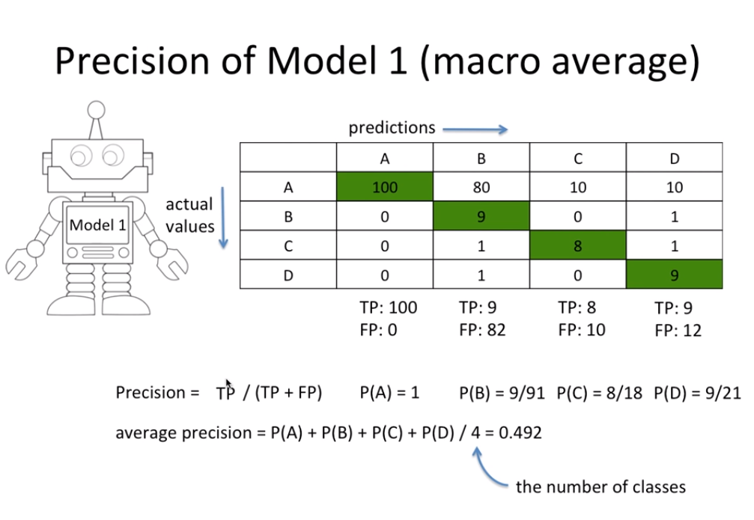
Sumon Ghosh (9836246393) [sumonghosh.87@gmail.com]

Slide 21
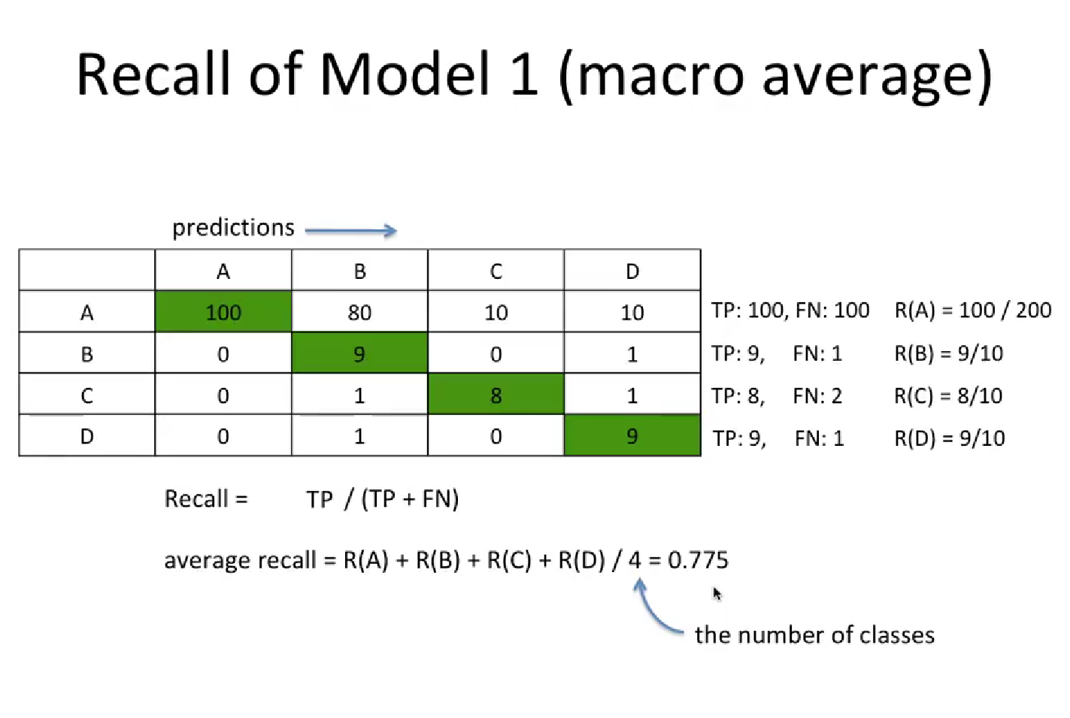
Sumon Ghosh (9836246393) [sumonghosh.87@gmail.com]

Slide 22
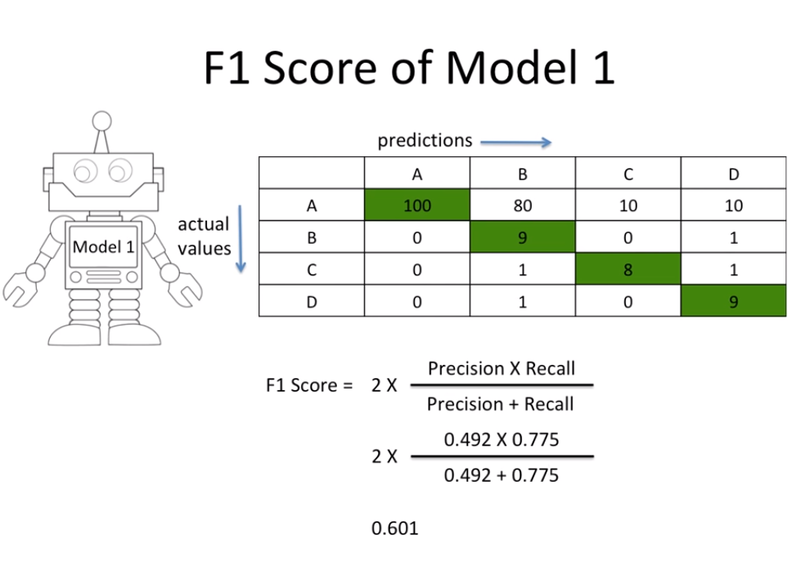
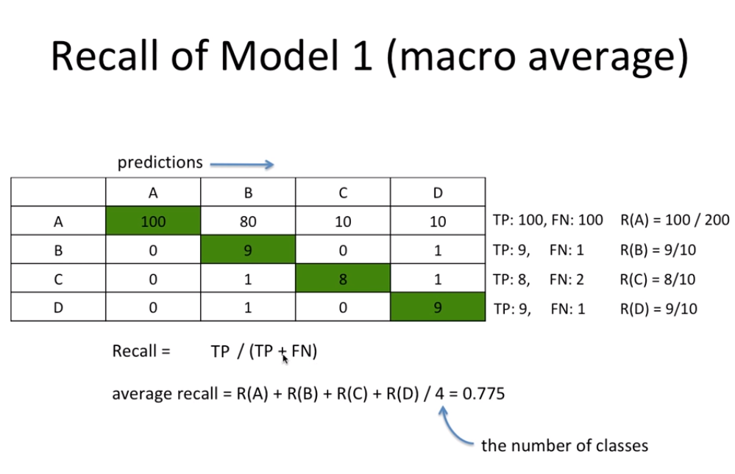
Sumon Ghosh (9836246393) [sumonghosh.87@gmail.com]

Slide 23
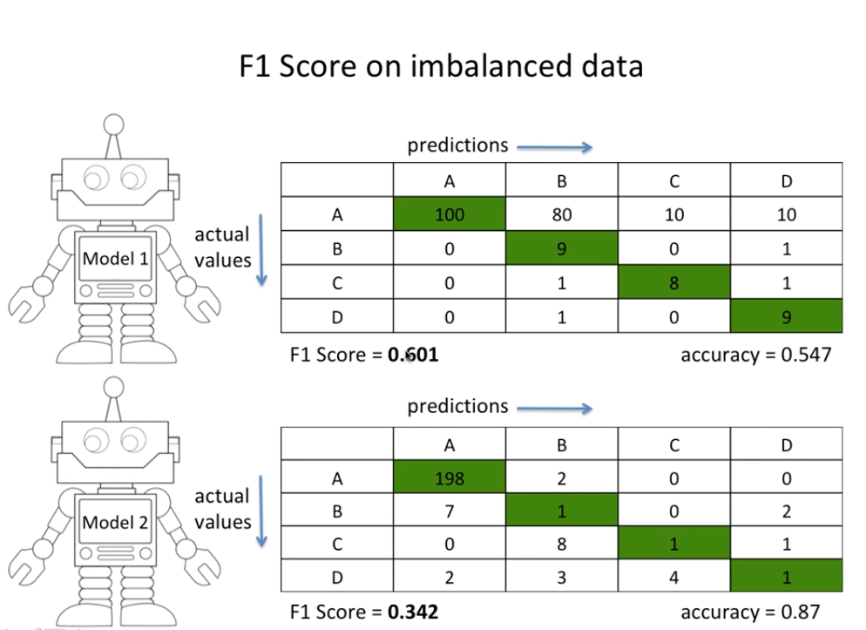
Sumon Ghosh (9836246393) [sumonghosh.87@gmail.com]

Slide 24
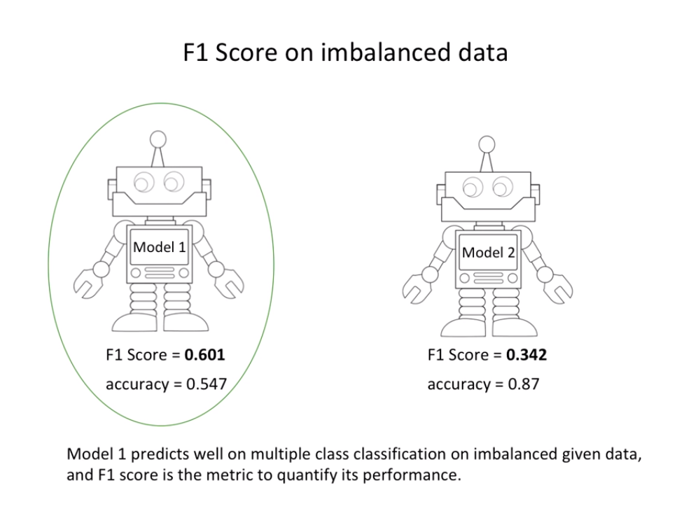
Sumon Ghosh (9836246393) [sumonghosh.87@gmail.com]

Slide 25
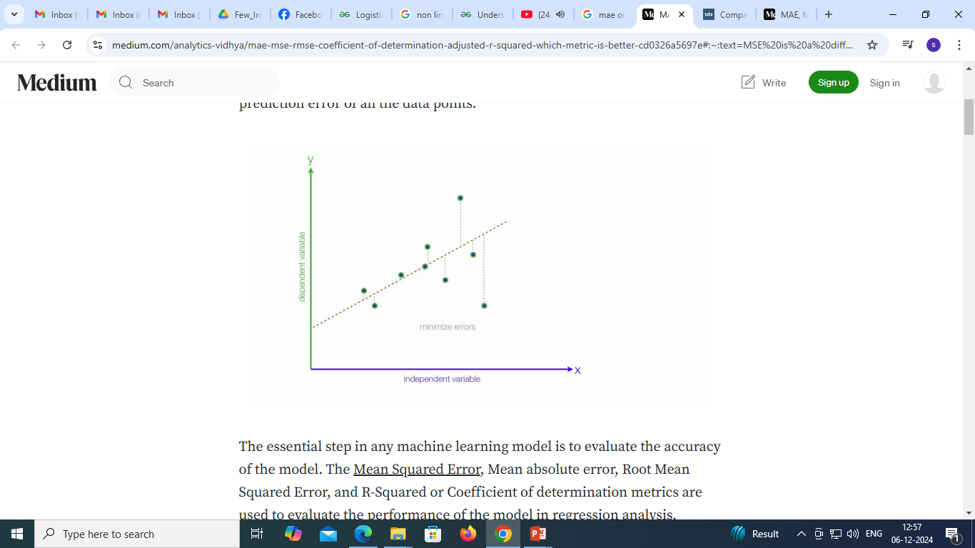
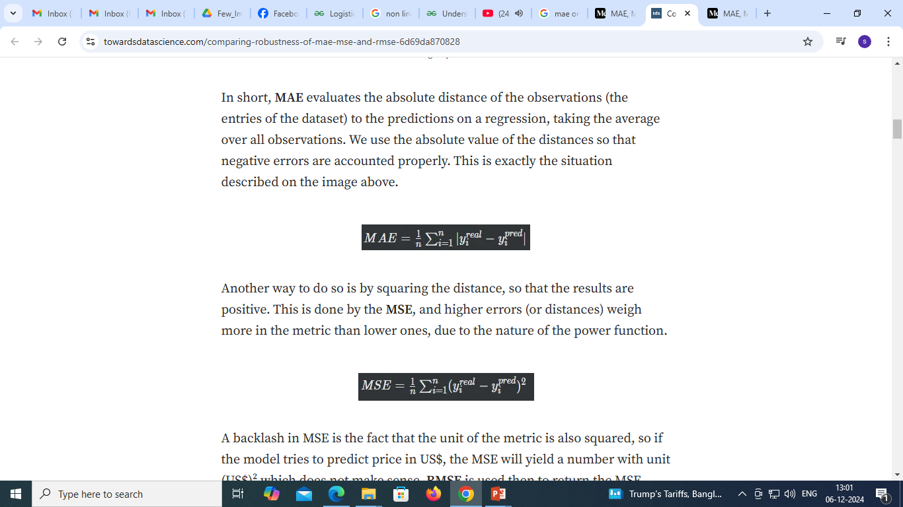
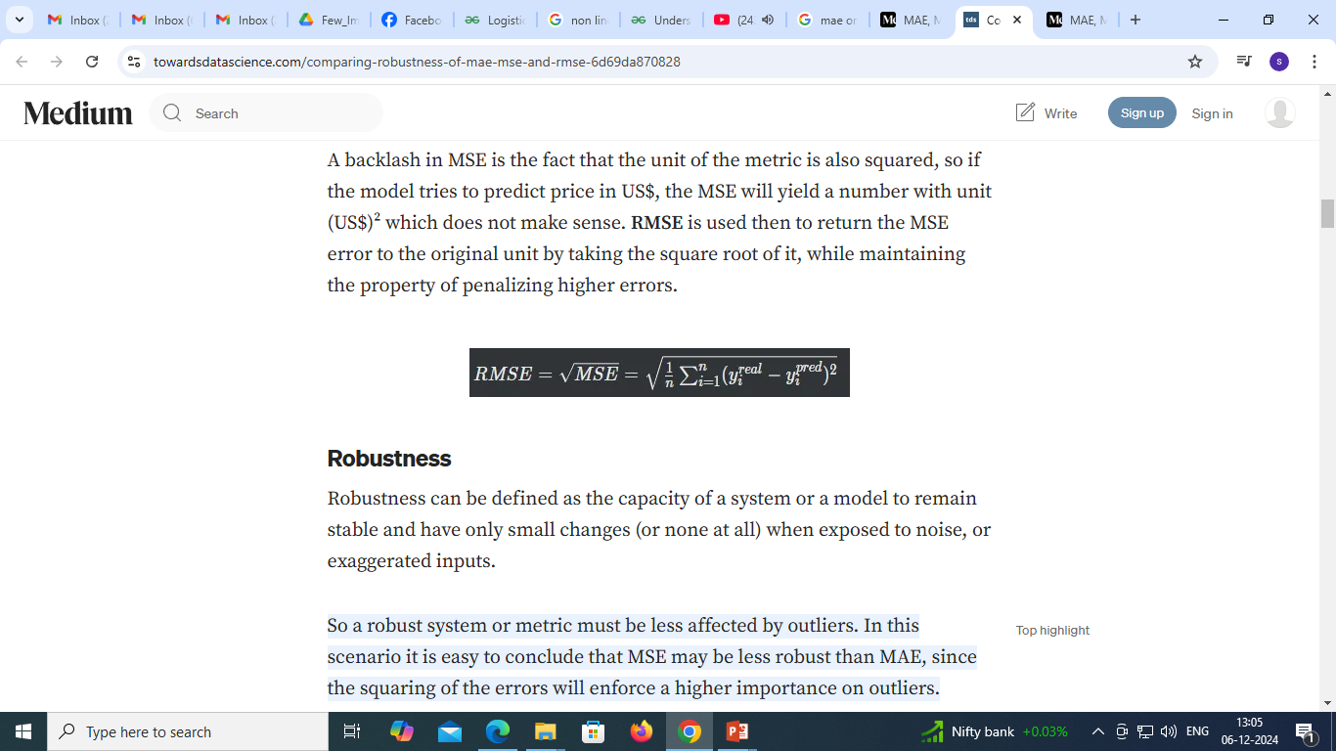
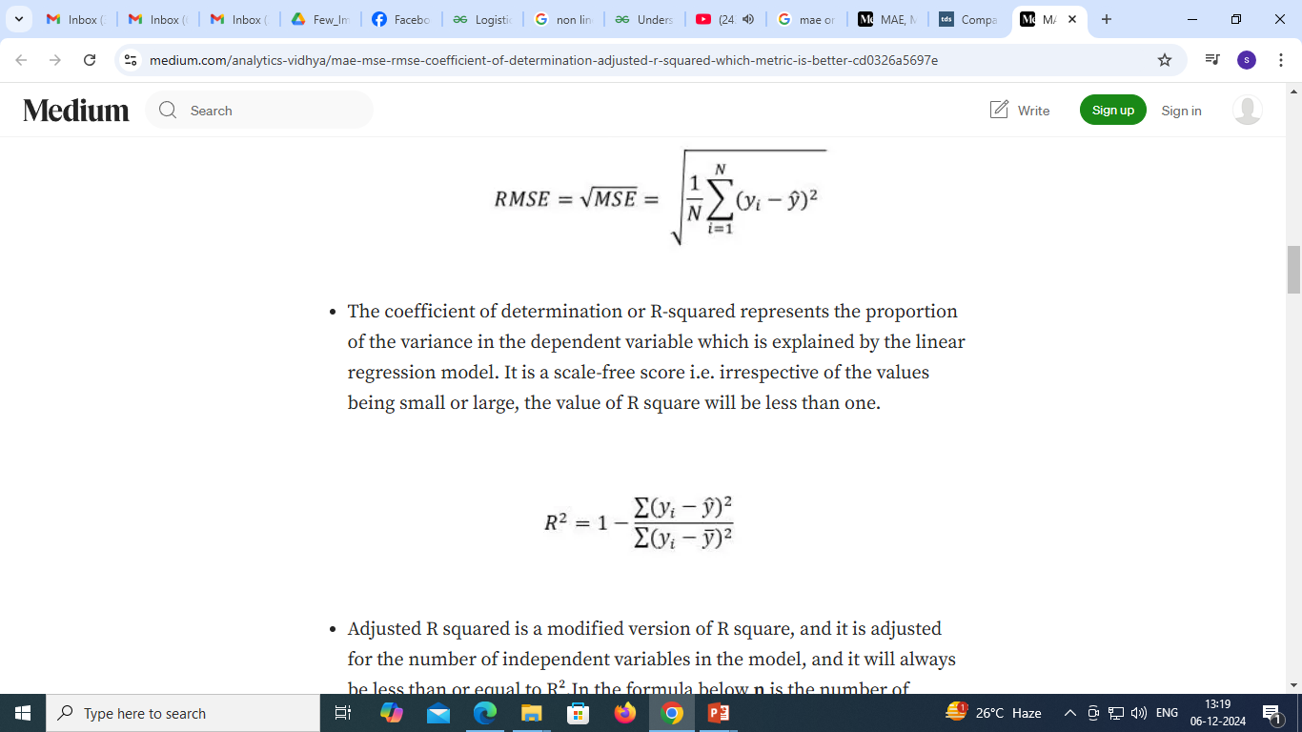
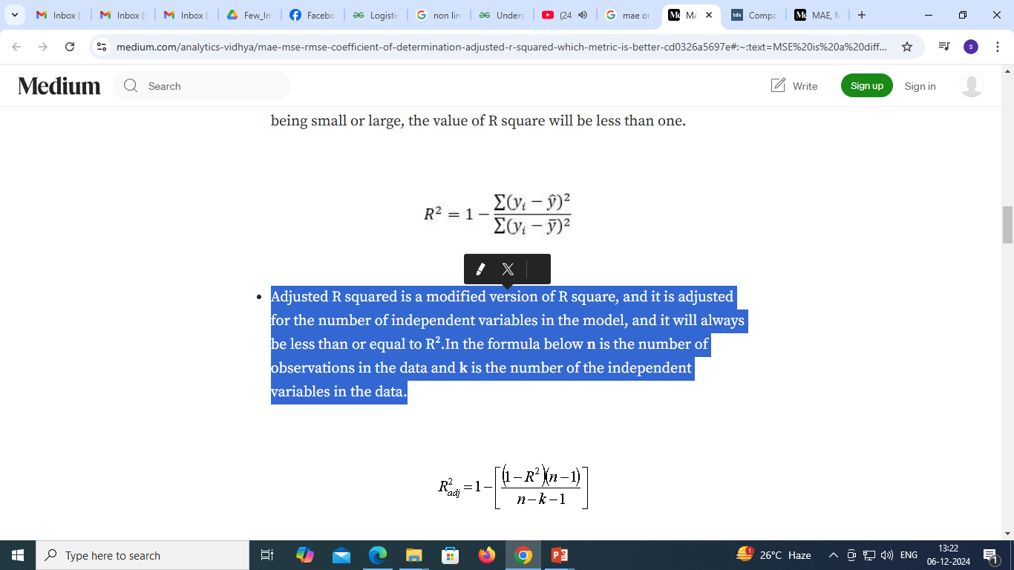
Mean Squared Error represents the average of the squared difference between the original and predicted values in the data set. It measures the variance of the residuals.
Mean Squared Error represents the average of the squared difference between the original and predicted values in the data set. It measures the variance of the residuals.
Root Mean Squared Error is the square root of Mean Squared error. It measures the standard deviation of residuals.
The coefficient of determination or R-squared represents the proportion of the variance in the dependent variable which is explained by the linear regression model. It is a scale-free score i.e. irrespective of the values being small or large, the value of R square will be less than one.
Adjusted R squared is a modified version of R square, and it is adjusted for the number of independent variables in the model, and it will always be less than or equal to R².In the formula below n is the number of observations in the data and k is the number of the independent variables in the data.
Sumon Ghosh (9836246393) [sumonghosh.87@gmail.com]

Slide 26
Differences among these evaluation metrics
Mean Squared Error(MSE) and Root Mean Square Error penalizes the large prediction errors vi-a-vis Mean Absolute Error (MAE). However, RMSE is widely used than MSE to evaluate the performance of the regression model with other random models as it has the same units as the dependent variable (Y-axis).
MSE is a differentiable function that makes it easy to perform mathematical operations in comparison to a non-differentiable function like MAE. Therefore, in many models, RMSE is used as a default metric for calculating Loss Function despite being harder to interpret than MAE.
The lower value of MAE, MSE, and RMSE implies higher accuracy of a regression model. However, a higher value of R square is considered desirable.
R Squared & Adjusted R Squared are used for explaining how well the independent variables in the linear regression model explains the variability in the dependent variable. R Squared value always increases with the addition of the independent variables which might lead to the addition of the redundant variables in our model. However, the adjusted R-squared solves this problem.
Adjusted R squared takes into account the number of predictor variables, and it is used to determine the number of independent variables in our model. The value of Adjusted R squared decreases if the increase in the R square by the additional variable isn’t significant enough.
For comparing the accuracy among different linear regression models, RMSE is a better choice than R Squared.
Sumon Ghosh (9836246393) [sumonghosh.87@gmail.com]

